Slide 1
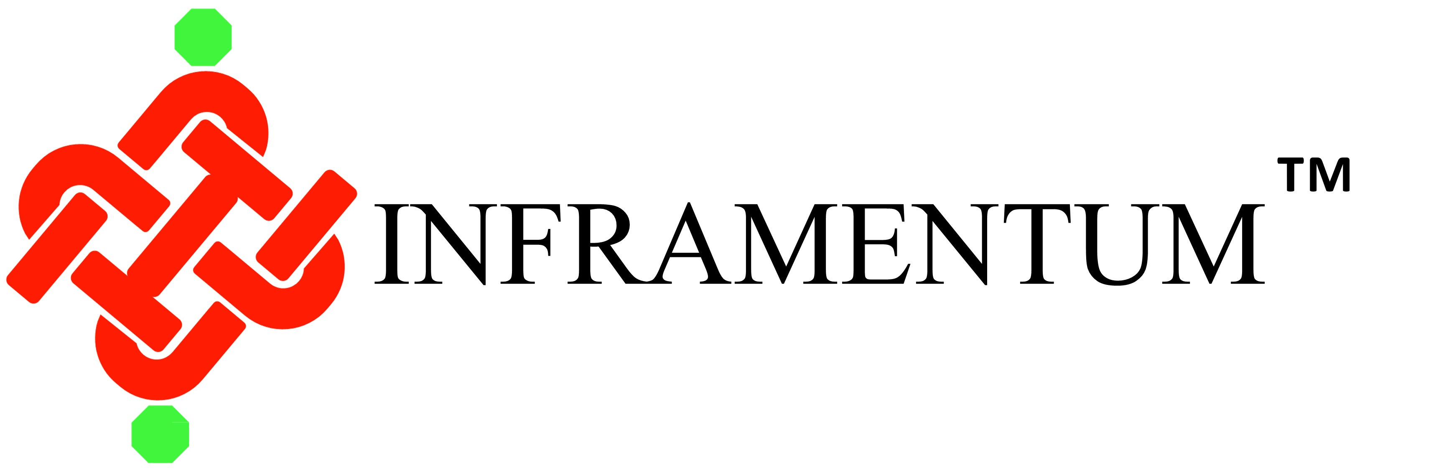
"Empowering Businesses Through Flexible Ownership and Rental Solutions for Clean Energy Assets"

Slide 2

Introduction

Slide 3
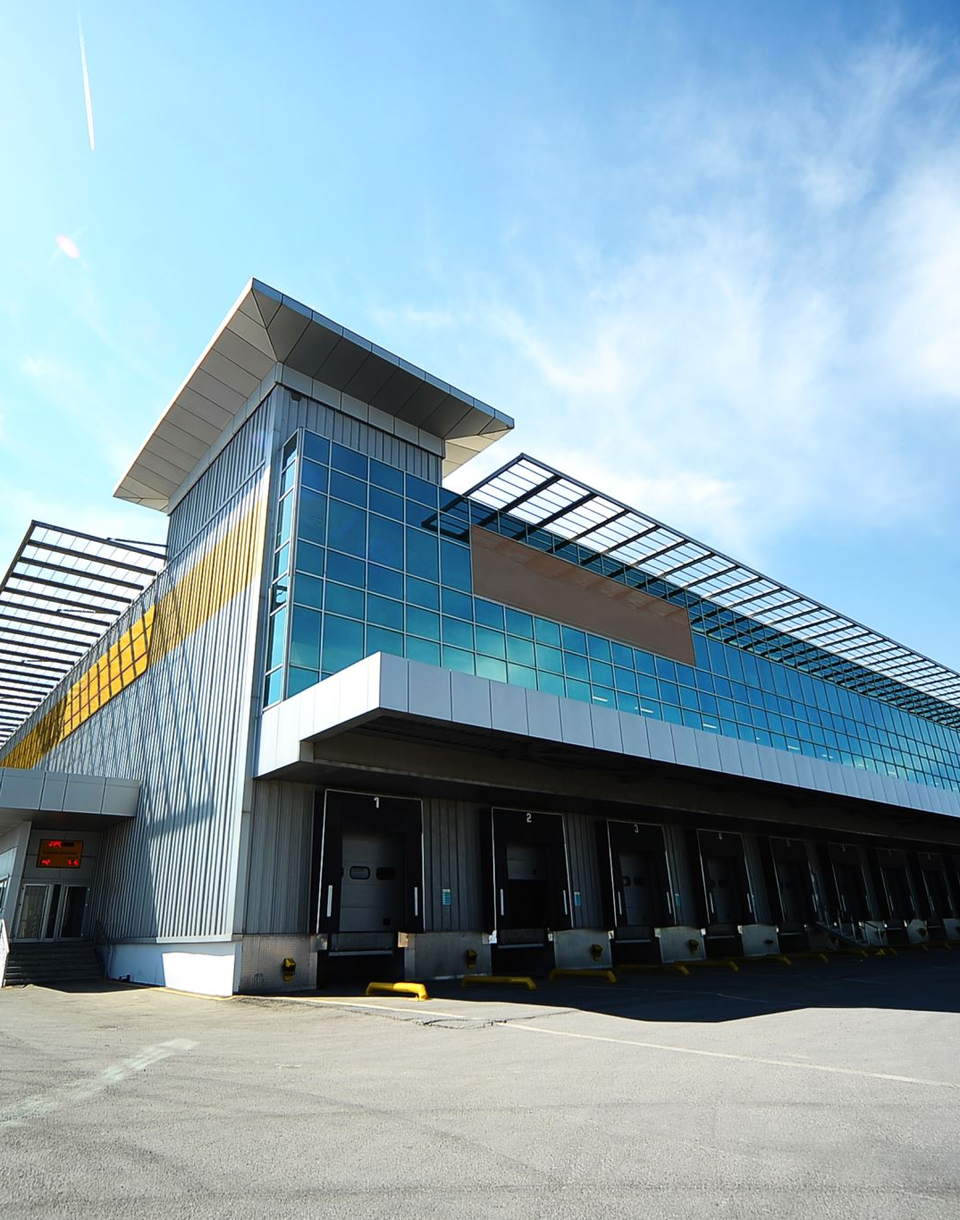
About INFRAMENTUM™
Inframentum™ is a Company focused on Asset Life Cycle Management for Renewable Energy, Water and sustainable Infrastructure assets.
Experienced founders with a track record of over 100 + years covering
Infrastructure Finance
Construction Equipment and Logistics Finance
Equipment Leasing and Rental including trading in refurbished equipments
Renewable Energy Industry value chain
The Company’s target segments are predominantly those enterprises that require to transition to clean energy across all their core operations. The domain expertise of the founders is enabling the focus towards those businesses that are
Infrastructure, Quarrying & Mining Enterprises
Manufacturing and Service Sector for Energy reduction
Logistics, Urban Infrastructure, Commercial segments

Slide 4
About INFRAMENTUM™
Our Mission
“To empower the transition to sustainable energy by delivering innovative, data-driven asset life cycle management solutions. We are committed to optimizing the performance, reliability, and longevity of renewable energy assets, enabling our clients to achieve their environmental and financial goals while contributing to a cleaner, greener future for all”
Our Vision
“To be among global leaders in renewable energy asset management, enabling sustainable energy infrastructure through innovative and affordable solutions. We envision a world where every renewable energy asset operates at peak efficiency, contributing to a resilient and sustainable energy future for generations to come”

Slide 5
Services

Slide 6
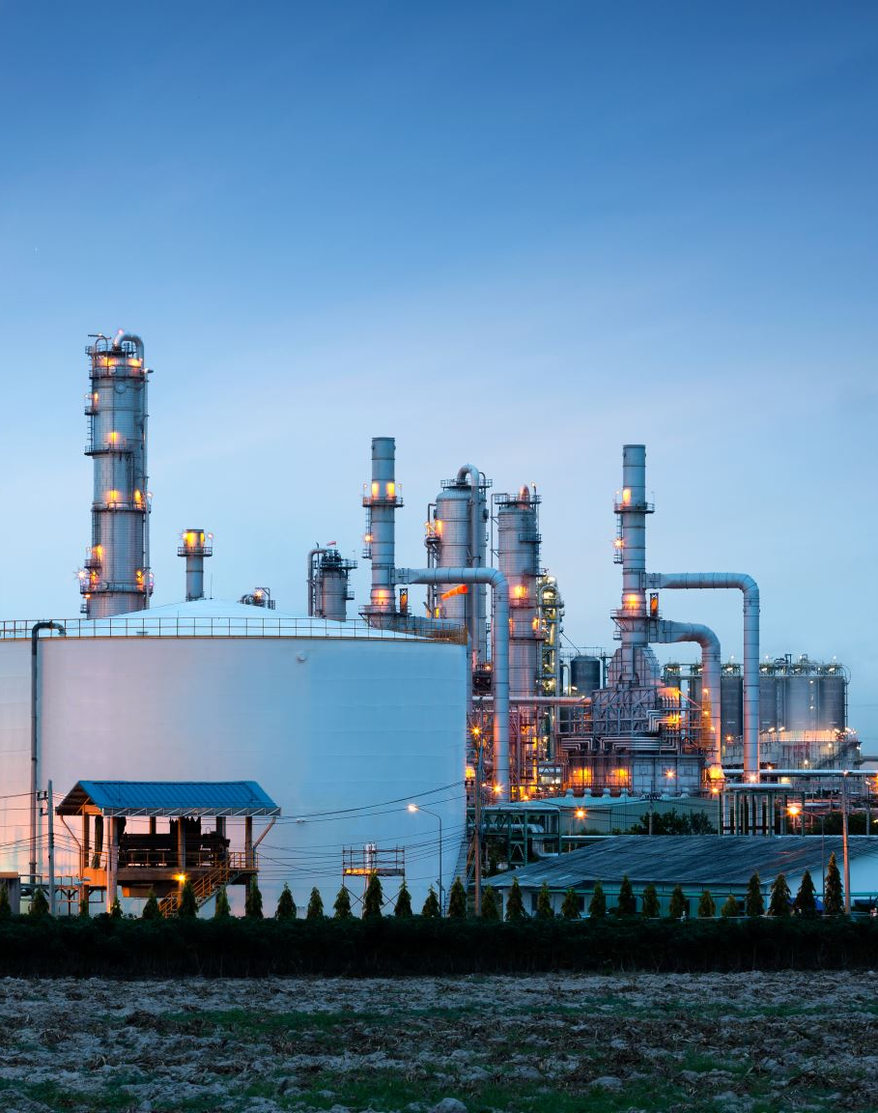
Asset Life Cycle Management Solutions
RE-ALCM platform provides
Renewable Energy Asset Life Cycle Management Services addressing
Management of renewable energy assets—such as solar panels, wind turbines, and energy storage systems—throughout their entire life cycle, from planning and design to decommissioning and recycling.
Through Implementation of specialised solutions, RE-ALCM can enable clients to enhance the performance, efficiency, and profitability of renewable energy projects.

Slide 7
Asset Planning and Design
Simulation and Modelling Tools: Use advanced software for simulation and modelling to optimize the design of renewable energy projects, ensuring they are cost-effective and aligned with long-term performance goals.
Feasibility Analysis: Conduct comprehensive feasibility studies to assess site conditions, resource availability, and regulatory requirements. In future we are building capacity to enable these analyses through usage of Artificial Intelligence and Big Data

Slide 8
Asset Procurement
Supplier Management Solutions: Provide support to manage relationships with suppliers, ensuring that components meet quality standards and are delivered on time. In future we plan to enable these through automated solutions with minimal requirement of manpower
Contract Management: Enable automated contract management systems to streamline procurement processes and ensure compliance with contractual obligations.

Slide 9
Construction, Installation and Commissioning
Project Management Support: Our clients can use our services to not only have the entire project managed right from initiation, construction, installation and commissioning. They can also utilize project management tools to oversee construction schedules, resource allocation, and budgetary control.
Cloud based Inspection: We provide real-time monitoring of projects post commissioning through usage of IoT solutions.
In Future we propose to deploy drones and AI for real-time monitoring of construction sites, ensuring that installations are performed correctly and identifying any issues early to minimise time and cost over-runs.

Slide 10
Operation and Maintenance (O&M)
Predictive Maintenance: Implement AI-driven predictive maintenance to forecast potential failures and optimize maintenance schedules, reducing downtime and repair costs.
Remote Monitoring Systems: Use IoT and SCADA systems for continuous, real-time monitoring of asset performance, allowing for quick responses to any operational issues.
Energy Management Software: Integrate energy management systems to optimize the performance of renewable energy assets, ensuring they generate the maximum possible energy.

Slide 11
Performance Optimization
Predictive Maintenance: Implement AI-driven predictive maintenance to forecast potential failures and optimize maintenance schedules, reducing downtime and repair costs.
Remote Monitoring Systems: Through IoT and SCADA systems for continuous, real-time monitoring of asset performance, allowing for quick responses to any operational issues.
Energy Management Software: Integrate energy management systems to optimize the performance of renewable energy assets, ensuring they generate the maximum possible energy.

Slide 12
Lifecycle Cost Management
Total Cost of Ownership (TCO) Analysis: Implement tools to analyse and manage the total cost of ownership of renewable assets, including capital expenditures, operational expenses, and end-of-life costs.
Financial Management Solutions: Use specialized software to manage the financial aspects of renewable energy projects, including funding, investment analysis, and financial forecasting.

Slide 13
Compliance and Reporting
Regulatory Compliance Management: Use compliance management tools to ensure that renewable energy assets meet all local, national, and international regulatory requirements.
Sustainability Reporting: Implement software for tracking and reporting on sustainability metrics, such as carbon emissions reductions and resource efficiency.

Slide 14
Compliance and Reporting
Regulatory Compliance Management: Use compliance management tools to ensure that renewable energy assets meet all local, national, and international regulatory requirements.
Sustainability Reporting: Implement software for tracking and reporting on sustainability metrics, such as carbon emissions reductions and resource efficiency.

Slide 15
End-of-Life Management
Decommissioning Planning: Develop detailed plans for the safe and cost-effective decommissioning of renewable energy assets, including the recycling or disposal of materials.
Asset Recycling Solutions: Utilize specialized solutions for the recycling of renewable energy components, such as solar panels and wind turbine blades, to minimize environmental impact.

Slide 16
Digital Twin Technology
Digital Twin Models: Create digital twins of renewable energy assets to simulate, monitor, and optimize their performance throughout the life cycle, providing insights into maintenance needs, efficiency improvements, and lifespan extension.

Slide 17
Blockchain for Asset Management
Blockchain Integration: Use blockchain technology to enhance transparency and security in renewable energy asset management, particularly in areas like energy trading, contract management, and supply chain traceability.

Slide 18
Equipment Rental Solutions
I-RentalFirst platform advocates
Energy-Efficient Fleet
Eco-Friendly Equipment: Enabling clients to invest and operate energy-efficient and low-emission equipment, such as battery-operated Material Handling Equipments, Electric Construction Equipments to address the reduction of carbon footprint as well as increase efficiency, productivity and financial viability
Alternative Power Sources: Providing equipments that use renewable energy sources, like solar-powered generators or electric vehicles.

Slide 19
Equipment Lifecycle Management
I-RentalFirst platform enables through our after-buy services
Preventive Maintenance: Implement rigorous maintenance programs to extend the lifespan of equipment, ensuring that assets are used efficiently, and waste is minimized.
Refurbishment and Recycling: Focus on refurbishing older equipment and recycling parts, keeping resources in use for as long as possible.

Slide 20
Sustainable Supply Chain
I-RentalFirst platform enables through our value-added partnerships with
Eco-Friendly Suppliers: Equipment manufacturers and suppliers that prioritize sustainability through their green energy assets, by enabling them to participate in our Manufacturer or Dealer led programs for Rental verticals
Local Sourcing: Our association with Manufacturer representatives locally enables us to Focus on sourcing equipment and parts locally to reduce transportation emissions and support local businesses.

Slide 21
Flexible Rental and Leasing Options
I-RentalFirst platform enables through our value-added partnerships with
Short-Term and Long-Term Rentals: Offer flexible rental terms that allow customers to rent equipment for short-term or long-term projects, reducing the need for capital expenditure and promoting sustainable usage.
Lease-to-Own Programs: Provide lease-to-own options for customers looking to invest in sustainable equipment over time.

Slide 22
Green Certification Support
Inframentum™ platform enables through our value-added partnerships with
LEED and Green Building Certification Assistance: Provide support services to help clients achieve green building certifications such as LEED, including equipment documentation and energy efficiency compliance.
Carbon Footprint Reduction Programs: Offer tools and guidance to help clients reduce their carbon footprint through the use of sustainable equipment and practices.

Slide 23
Sustainability Reporting and Compliance
Inframentum™ platform enables through our value-added partnerships with
Environmental Impact Reporting: Provide detailed reports on the environmental impact of rented equipment, including energy usage, emissions, and carbon footprint.
Regulatory Compliance Support: Assist clients in ensuring that their use of rental equipment complies with environmental regulations and sustainability standards.

Slide 24
Financial services for RE Sector
Inframentum™ enables a wide range of financial services that support the growth and development of various players within the industry, including project developers, equipment manufacturers, utility companies, and investors.

Slide 25
Capital Raising for RE Sector
Equity Financing: Assist renewable energy companies in raising capital through the issuance of equity, including initial public offerings (IPOs), follow-on offerings, private placements, and venture capital funding.
Debt Financing: Arrange debt financing options, such as corporate bonds, green bonds, and syndicated loans, to fund renewable energy projects and corporate expansion.
Mezzanine Financing: Provide mezzanine financing as a hybrid between debt and equity, offering flexibility and allowing companies to raise additional capital without diluting ownership significantly.

Slide 26
Mergers and Acquisitions (M&A)
M&A Advisory: Advise on mergers, acquisitions, and divestitures within the renewable energy sector, including target identification, valuation, and deal structuring.
Strategic Partnerships and Joint Ventures: Facilitate the formation of strategic alliances, joint ventures, and partnerships between companies in the renewable energy space, helping to expand market reach and share resources.
Cross-Border Transactions: Provide expertise in managing cross-border M&A transactions, ensuring compliance with local regulations and optimizing tax efficiency

Slide 27
Project Financing
Non-Recourse and Limited Recourse Financing: Arrange project financing for renewable energy projects, where the repayment is primarily based on the project's cash flows rather than the sponsors' balance sheets.
Construction Financing: Offer financing solutions for the construction phase of renewable energy projects, including bridge loans and construction loans.
Securitization of Cash Flows: Structure securitization deals where future cash flows from renewable energy projects, such as power purchase agreements (PPAs), are bundled and sold to investors as securities.

Slide 28
Financial Advisory
Valuation Services: Provide valuation services for renewable energy assets, companies, and projects, using various methodologies like discounted cash flow (DCF), comparable company analysis (CCA), and precedent transactions.
Financial Restructuring: Assist companies in the renewable energy sector with financial restructuring, including debt restructuring, refinancing, and corporate reorganisation.
Risk Management: Offer risk management solutions, including hedging strategies for commodity prices, interest rates, and foreign exchange risks related to renewable energy projects.

Slide 29
Market Entry and Expansion Strategies
Market Analysis and Feasibility Studies: Conduct market analysis, feasibility studies, and due diligence for companies looking to enter new markets or expand their renewable energy operations.
Regulatory and Compliance Advisory: Provide advisory services on navigating regulatory environments, securing permits, and complying with local, national, and international regulations.

Slide 30
Asset Management and Structured Finance
Asset Securitization: Structure and manage asset-backed securities (ABS) linked to renewable energy assets, allowing companies to monetize their projects and raise capital.
Yieldco Formation: Assist in the formation of Yieldcos, which are publicly traded companies that own operating renewable energy assets and distribute cash flows to investors.
Portfolio Management: Offer portfolio management services for investors in renewable energy assets, optimizing returns and managing risks.

Slide 31
Green Bonds and Sustainability-Linked Financing
Green Bond Issuance: Advise on and facilitate the issuance of green bonds, where the proceeds are used exclusively for financing environmentally sustainable projects, such as renewable energy.
Sustainability-Linked Loans: Arrange sustainability-linked loans, where the terms (e.g., interest rates) are linked to the borrower’s performance against predefined sustainability targets.
Climate Bonds: Support the issuance of climate bonds aimed at financing projects that contribute to climate change mitigation and adaptation.

Slide 32
Private Placements and Venture Capital
Private Equity Placements: Arrange private equity placements for renewable energy companies seeking growth capital from institutional investors, including private equity firms and sovereign wealth funds.
Venture Capital Funding: Facilitate venture capital funding for early-stage renewable energy startups, helping them scale their operations and develop new technologies.
Family Office and High-Net-Worth Individual (HNWI) Placements: Connect renewable energy companies with family offices and HNWIs interested in sustainable and impact investing.

Slide 33
Corporate Finance Services
Dividend Policy Advisory: Advise on dividend policies, helping renewable energy companies balance shareholder returns with reinvestment in growth and sustainability.
Treasury and Cash Management: Provide treasury management services to optimize cash flows, manage liquidity, and reduce the cost of capital.
Tax Optimization: Offer tax advisory services to optimize the tax structure of renewable energy projects and investments, including tax equity financing.

Slide 34
Investor Relations and Market Communication
Investor Relations Support: Provide support in managing investor relations, including the development of investor presentations, roadshows, and communication strategies for public companies in the renewable energy sector.
Market Positioning and Branding: Assist companies in positioning themselves as leaders in the renewable energy market, including branding and communication strategies.

Slide 35
Sustainable Investment Advisory
Impact Investing: Advise on and structure impact investments in renewable energy, where the focus is on generating positive environmental and social outcomes alongside financial returns.
ESG Advisory: Provide environmental, social, and governance (ESG) advisory services to help renewable energy companies align their operations and strategies with ESG best practices, attracting responsible investment.

Slide 36
Exit Strategies
IPO Advisory: Prepare and advise renewable energy companies on going public through an IPO, including valuation, underwriting, and market timing.
Strategic Sale or Spin-Off: Advise on the sale or spin-off of renewable energy assets or business units as part of a broader corporate strategy.

Slide 37
Exit Strategies
IPO Advisory: Prepare and advise renewable energy companies on going public through an IPO, including valuation, underwriting, and market timing.
Strategic Sale or Spin-Off: Advise on the sale or spin-off of renewable energy assets or business units as part of a broader corporate strategy.

Slide 38

VALUE PROPOSITION
Inframentum™ is a Clean Energy Asset Life Cycle Management Platform addressing flexible ownership of
Solar and Wind Power based Assets
Clean Energy Drinking Water Assets
Operating Lease and Rental of Electric Construction and Material Handling Equipments
We enable our platform users for
Consumption of Lower Levelised Cost of Energy
Through Green energy sources while
Investing, Managing or Trading in Renewable Energy.
To augment optimal usage of the generated power, we also assist in acquiring Clean energy assets through our Operating Lease and Rental Platform

Slide 39
Our Target Customers
RE-ALCM
Renewable Energy EPC companies
Renewable Energy Consultants and Advisors
Buyers of Clean Energy
Sellers of Clean Energy
Investors in Clean Energy
Financial Institutions financing clean energy assets
RENTALFIRST
Infrastructure Developers
Logistics and Warehousing
Mining & Quarrying Businesses
Data Centres
Commercial & Residential Complexes
Industries, SMEs and Large Manufacturing and Services set ups

